Slide 1
Figures

Slide 2
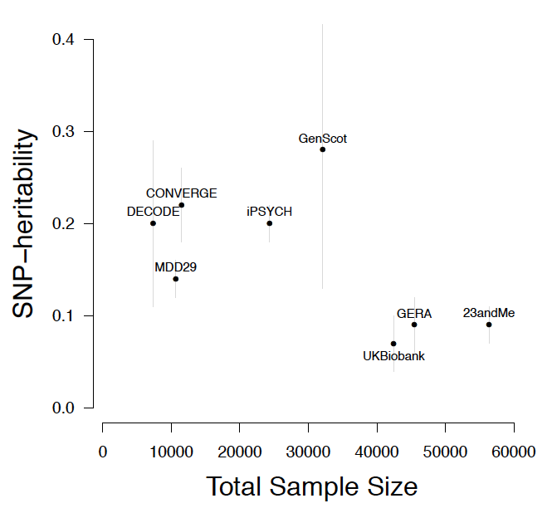
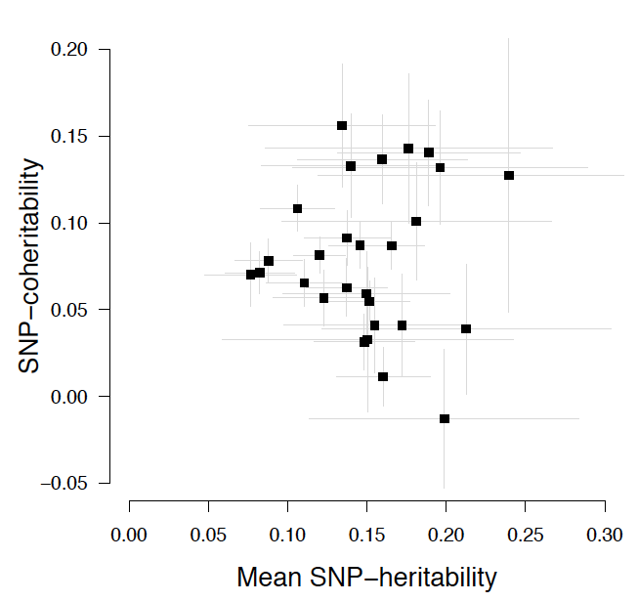
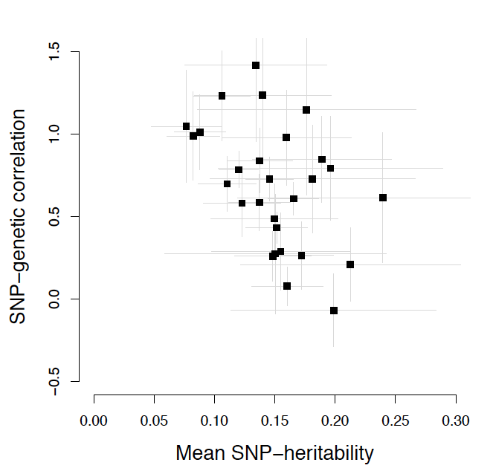
(a)
 | Anchor MDD N=42455 P=0.40 K=0.10/0.15 | deCODE N=11516 P=0.17 K=0.10/0.15 | GenScot N=7355 P=0.14 K=0.10/0.15 | GERA N=45469 P=0.16 K=0.10/0.15 | iPSYCH N=32089 P=0.51 K=0.10/0.15 | UK Biobank N=24337 P=0.34 K=0.10/0.15 | 23andMe N=56371 P =0.26 K=0.10/0.15 | CONVERGE N=10640 P = 0.50 K =0.036
Anchor MDD | 0.13 (0.02)/0.14(0.02)
deCODE | 0.98 (0.29) | 0.18 (0.08)/0.2 (0.09)
GenScot | 0.79 (0.32) | 0.61 (0.39) | 0.25 (0.14)/0.28 (0.15)
GERA | 0.70 (0.17) | 1.42 (0.46) | 0.27 (0.36) | 0.08 (0.03)/0.09 (0.03)
iPSYCH | 0.61 (0.10) | 0.85 (0.26) | 0.21 (0.22) | 0.84 (0.20) | 0.18 (0.02)/0.20 (0.02)
UK Biobank | 1.23 (0.27) | 1.24 (0.38) | 1.15 (0.52) | 1.05 (0.34) | 0.59 (0.17) | 0.06 (0.02)/0.07 (0.03)
23andMe | 0.78 (0.11) | 0.49 (0.21) | 0.73 (0.33) | 1.01 (0.23) | 0.73 (0.13) | 0.99 (0.27) | 0.08 (0.01)/0.09 (0.02)
CONVERGE | 0.26 (0.20) | 0.25 (0.17) | -0.05 (0.68) | 0.26 (0.15) | 0.07 (0.09) | 0.51 (0.18) | 0.43 (0.09) | 0.22 (0.04)
(b)
(c)
(d)
Notes:
FIGURE 1

Slide 3
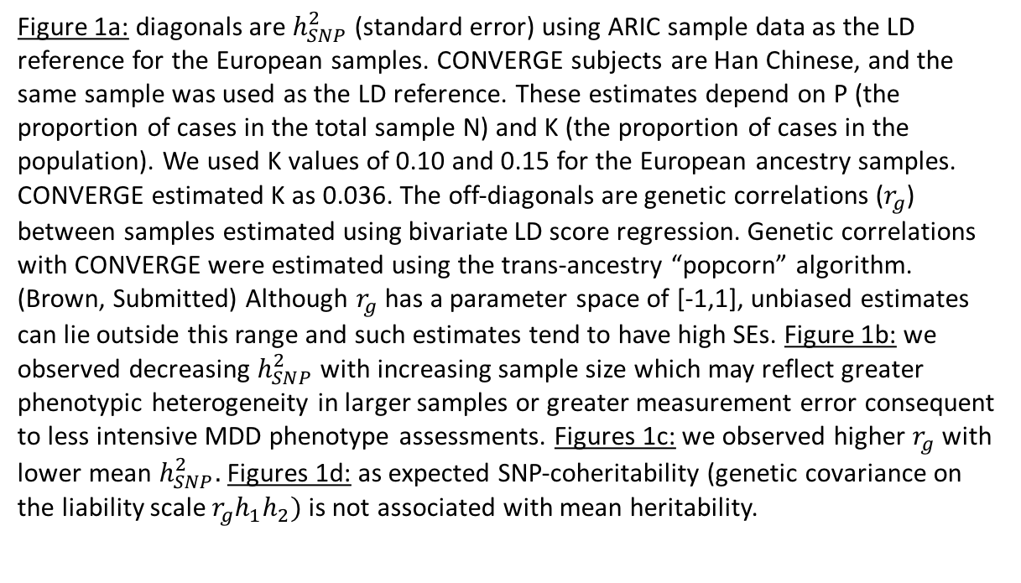
Figure 1a: diagonals are $h_{SNP}^{2}$ (standard error) using ARIC sample data as the LD reference for the European samples. CONVERGE subjects are Han Chinese, and the same sample was used as the LD reference. These estimates depend on P (the proportion of cases in the total sample N) and K (the proportion of cases in the population). We used K values of 0.10 and 0.15 for the European ancestry samples. CONVERGE estimated K as 0.036. The off-diagonals are genetic correlations ($r_{g}$) between samples estimated using bivariate LD score regression. Genetic correlations with CONVERGE were estimated using the trans-ancestry “popcorn” algorithm. (Brown, Submitted) Although $r_{g}$ has a parameter space of [-1,1], unbiased estimates can lie outside this range and such estimates tend to have high SEs. Figure 1b: we observed decreasing $h_{SNP}^{2}$ with increasing sample size which may reflect greater phenotypic heterogeneity in larger samples or greater measurement error consequent to less intensive MDD phenotype assessments. Figures 1c: we observed higher $r_{g}$ with lower mean $h_{SNP}^{2}.$ Figures 1d: as expected SNP-coheritability (genetic covariance on the liability scale $r_{g}h_{1}h_{2})$is not associated with mean heritability.

Slide 4
(a)
(b)
Need to add chrX
Notes:
FIGURE 2

Slide 5
Supplemental Figures

Slide 6
(a)
(b)
Notes:
Supplemental Figure 1: QQ and Manhattan plots for the anchor MDD samples

Slide 7
Nine forest plots
Notes:
Supplemental Figure 2: nine forest plots

Slide 8
Nine regional plots
Notes:
Supplemental Figure 3: nine regional plots

Slide 9
Plot of chromosome size (mpb) on X axis, SNP-chromosome h2 on Y axis.
Please include chrX if possible!
Notes:
Supplemental Figure 4: SNP heritability by chromosome

Slide 10
polygenic score analysis
Notes:
Supplemental Figure 5: polygenic score analysis

Slide 11
GRS decile by OR plot
Notes:
Supplemental Figure 6: decile by OR plot

Slide 12
Baseline. mdd2 top, scz2 bottom. Conserved is notable for both

Slide 13
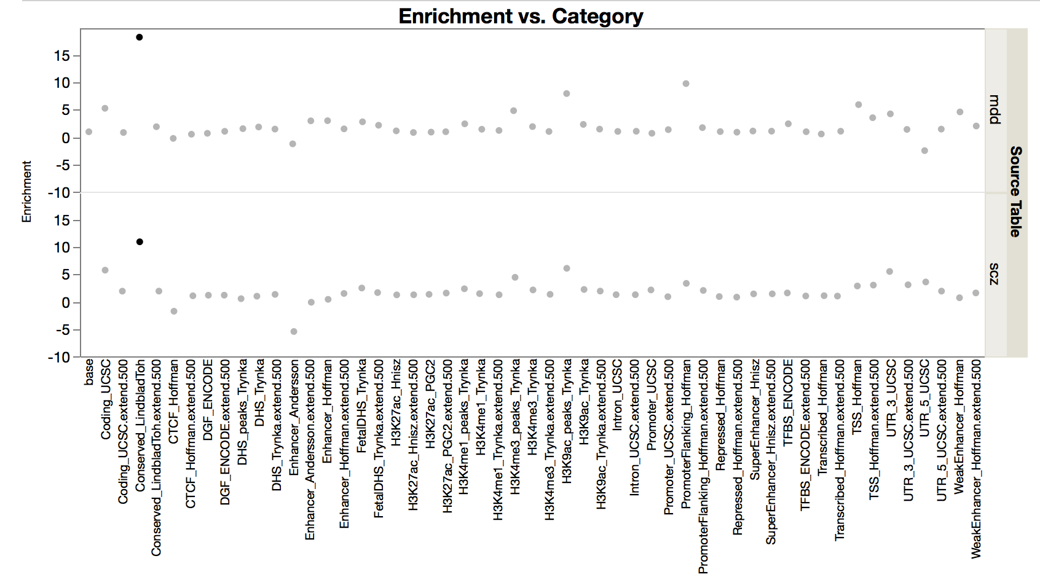
Notes:
Supplemental Figure 7: stratified LD score regression

